Slide 1
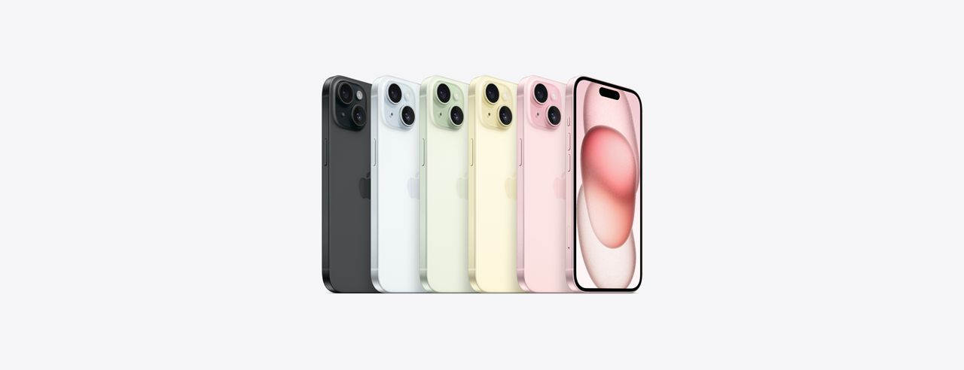
iPhone 15 Release –
The perception that surrounds

Slide 2
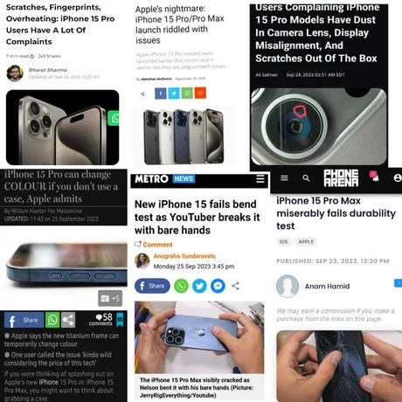
1
Sentiment Analysis
Analyzing public perception by:
1. Examining comments / reviews
2. Gauging emotional impact on consumers
Is there an indication of waning interest for the new flagship iPhone?
2
Topic Modeling
Is there an indication of waning interest for the new flagship iPhone?
Is there an indication of waning interest for the new flagship iPhone?
A word cloud representing popular topics being discussed on forums
3
Comparison with iPhone14
Understanding the preferences and concerns of consumers
4
Final Recommendation
Synergizing Apple team's knowledge and consumer input for iPhone 16 launch

Slide 3
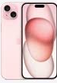
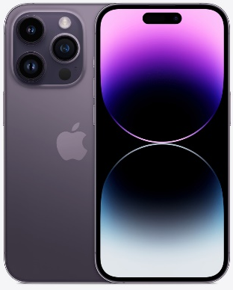


iPhone 15 vs iPhone 14: last year's Pro in disguise?
Performance
Performance
4nm A16 Bionic chip; 6 core GPU
Introduction of A17 Pro Bionic chip – A technological leap!
A16 Bionic chip;
5 core GPU
Display, Design & Build
Display, Design & Build
2,000 nits peak brightness; 1.55mm screen – thinnest ever!
New Titanium finish – Lighter!
2,000 nits peak brightness; 2.17mm screen
Aluminium body
Lights, Camera, Action!
Lights, Camera, Action!
NEW 48MP Main Camera!
Upto 3x Telephoto zoom
New Spatial Video feature
12MP Main Camera
Upto3x Telephoto zoom
iPhone 14 Pro
iPhone 15
iPhone 14 Pro
Connectivity
Connectivity
Finally! Introduction of USB-C type – Compatible with MacBook chargers.
Lightning port – similar to previous iPhone models.
NO! There are some TITANIC technological advances in iPhone 15 series! But, how are the consumers reacting to these?

Slide 4
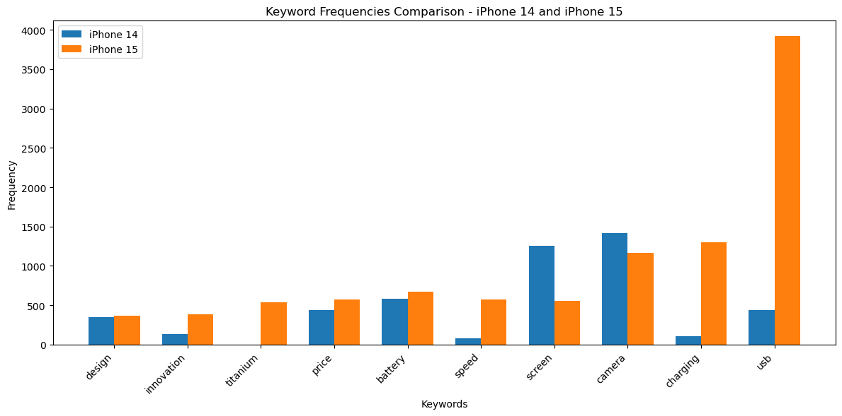
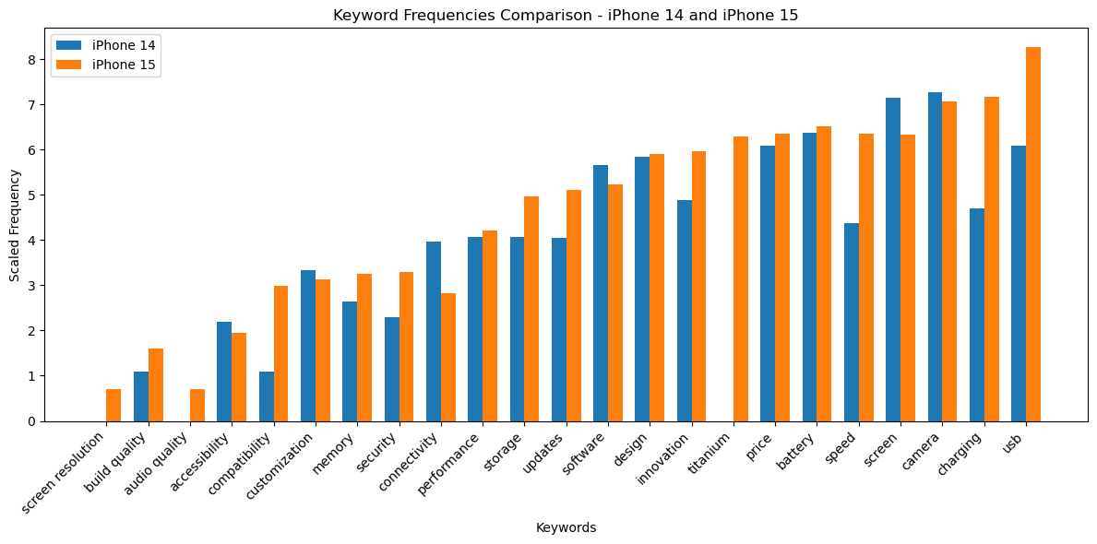



What are the consumers DISCUSSING on social media?
Step 1
Step 2
Step 3
Why are we trying to find the top ‘Keywords’?
How did we identify the top ‘Keywords’?
What are the hot TOPICS being discussed by consumers?
Pre-Launch Hype: Extensive discussion about iPhone 15 and iPhone 14. However, negative sentiment was noted
Consumer Topic Focus: Identifying key topics / features will shed light on their concerns and preferences
C
Analysis Methods: Employed keyword analysis and hypothesis testing as crucial methods
Word Frequency Analysis: Uncovered significant word frequencies to understand consumer sentiment using comments / threads
C
Key Keywords: Identified prominent keywords, including "design“, "innovation“, "titanium“, "price“
Consumer Priorities: Keywords highlighting consumer focus, such as "battery“, "speed“, "camera"

Slide 5
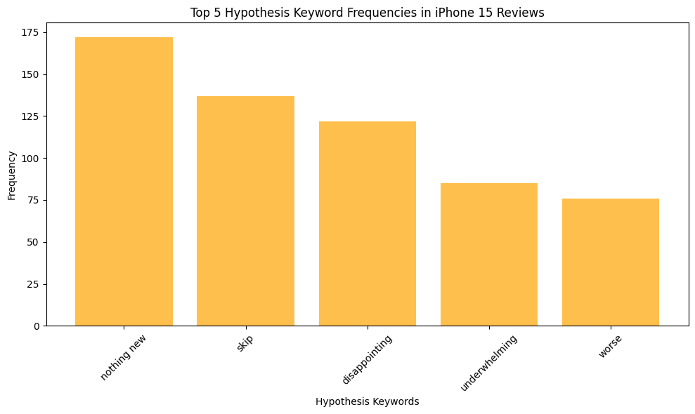
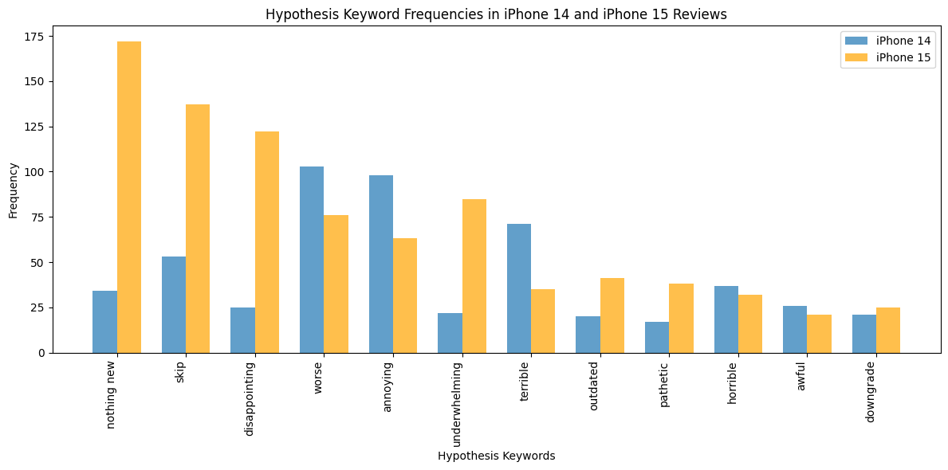
Consumers clearly seem NOT Satisfied with the launch
^{Negative Segment}
^{Consumer Discontent}
^{Critical Feedback}
Disappointing
Annoying
Underwhelming
Awful
Horrible
Nothing New
Skip
Overrated
Terrible
Downgrade

Slide 6
Sentiment Analysis reveals an increase in Dissatisfaction
Positive
Considerable proportion of the reviewers had positive experiences or perceptions of the product
47%
Negative
Portion of the reviewers had negative experiences or unfavorable opinions about iPhone 15
20%
iPhone 15
33%
Neutral
Do not strongly sway towards either positive or negative sentiments
Revealing trends in reviewer sentiment for iPhone 14 and iPhone 15, showing higher negativity for iPhone 15 and indicating areas for potential improvement
A significant portion of the reviewers expressed favorable opinions about iPhone 14
Positive
51%
Portion of the reviewers had unfavorable experiences or opinions regarding iPhone 14
Negative
19%
These reviews may contain objective information or mixed opinions
Neutral
30%
iPhone 14 Pro

Slide 7
Sentiment Analysis also reveals consumer concerns
Feature | Sentiment (iPhone 14) | Sentiment (iPhone 15)
Battery | Positive | Positive
Performance | Positive | Positive
Design | Negative | Positive
Storage | Negative | Positive
User Interface | Neutral | Neutral
Security | Positive | Negative
Build Quality | Positive | Negative
Camera | Positive | Positive
Screen | Positive | Neutral
What worked for iPhone 15 ?
Battery performance received positive sentiments for both iPhone 14 and iPhone 15
Performance, including the new A17 bionic chip, seems to have garnered positive feedback
iPhone 15’s design was well-received, with negative sentiments surrounding iPhone 14's design
Storage capacity received positive feedback for both models
What did NOT work for iPhone 15 ?
Security concerns led to a decline in customer sentiment compared to the previous model, which Apple aims to address with iOS upgrades
Heating issues were reported, impacting the positive sentiment regarding build quality
Negative sentiment towards iPhone 15's camera and a neutral perception of screen resolution suggest areas where the model did not meet customer expectations

Slide 8
Topics Extracted using LDA Analysis will help Internal Business
iPhone14
Topic 0 - iPhone Models: Customers compare various iPhone models, indicating demand for product diversity.
Topic 1 - Phone Life and Battery: Customers express concern about battery life, suggesting a need for optimization.
Topic 2 - Likability and Features: Customers discuss features they appreciate, an opportunity for effective marketing.
Topic 3 - Screen and Camera Quality: Discussions focus on screen and camera quality, offering areas for improvement.
Topic 4 - New iPhone Releases: Insights for product release planning and marketing strategies.
Business Value and Implications
These insights help Apple understand customer preferences and concerns, enabling product improvements tailored to customer needs.
The identified unique features can be highlighted in marketing to differentiate iPhone models from competitors.
Emphasizing fast charging and USB compatibility can attract tech-savvy consumers.
By addressing concerns related to battery life, screen quality, and camera features, Apple can enhance overall customer satisfaction and loyalty.
Understanding the switch from Android provides an opportunity to tailor marketing efforts to target a broader audience.
Effective communication of new releases and their features is vital for maintaining customer interest and loyalty.
iPhone15
Topic 0 - Unique Features: Customers discuss unique aspects of iPhone 15, an opportunity for highlighting these in marketing.
Topic 1 - Fast Charging and USB: Discussions about fast charging and USB compatibility, marketing focus areas.
Topic 2 - iPhone 15 Features: Insights on key features, valuable for effective marketing.
Topic 3 - USB and Android: Discussions on device compatibility, a chance to attract Android users.
Topic 4 - Camera and Button Layout: Customer opinions on camera and button layout, areas for improvement.

Slide 9
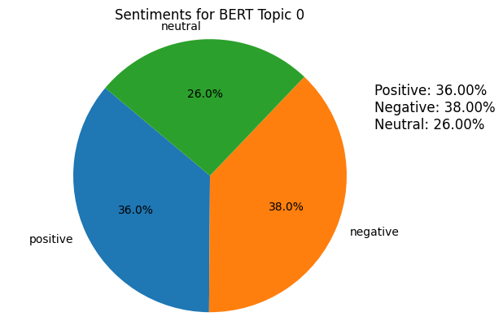
Topics Extracted using BERT Embeddings
iPhone14
Topic 0 - General Observations and Music: Discusses music in an advertisement, similarities to iPhone 13, and discontinuation of the iPhone Mini.
Topic 1 - Design and Display Innovations: Highlights subtle color choices and creative solutions for addressing the notch.
Topic 2 - Value Proposition and Pricing: Concerns about European pricing and minimal upgrades.
Topic 3 - Features and Missing Upgrades: Noting the notch and the absence of USB-C.
Topic 4 - Technical Specifications: Focuses on specific technical details and specs.
Sentiment Analysis on Topic 0 – iphone 15
When examining the "Features and Quality Reporting" (Topic 0) within iPhone 15 reviews, it becomes evident that a substantial portion of the feedback holds a negative sentiment. Specifically, 38% of users appear dissatisfied, expressing reservations about the features, battery life, and the overall quality of reporting. These criticisms underscore the need for enhancements in these areas.
iPhone15
Topic 0 - Features and Quality Reporting: Discusses features, battery life, and quality reporting.
Topic 1 - Device Evolution and Price Points: Explores iPhone's evolution and price barriers.
Topic 2 - Design and Aesthetics: Focuses on visual and tactile aspects.
Topic 3 - New Features and Innovations: Introduces innovative features like the Dynamic Island.
Topic 4 - Colors and Design Choices: Explores color options and design preferences.

Slide 10



Recommendations:
Address Emerging Concerns
Apple should conduct a deeper dive into the emerging concerns around 'security', 'audio quality', and 'build quality'
Continue Innovating
A focus on truly innovative features can heighten anticipation and user satisfaction
Price Rationalization
Considering pricing feedback, especially from non-US markets, Apple could revisit its pricing strategy
Enhance User Engagement
Apple could establish forums or platforms to gather user feedback post-launch directly

Slide 11
Thank you

